Slide 1
Culture Canvas Café & Art Gallery
Arjana
Notes:
My name is Arjana Muja, and I am presenting my final project on my client, Culture Canvas Cafe & Art Gallery.
I chose this topic because I really liked the idea of assisting with a business that is made for the community. Culture Canvas Cafe & Art Gallery combines an art gallery, cafe and social services that assists community members. I love the fact that this business is centered on creating a safe and creative environment where people can gather, support local artists and access resources.

Slide 2
Agenda: Final Project
Personas
Information Architecture
Prototype

Slide 3
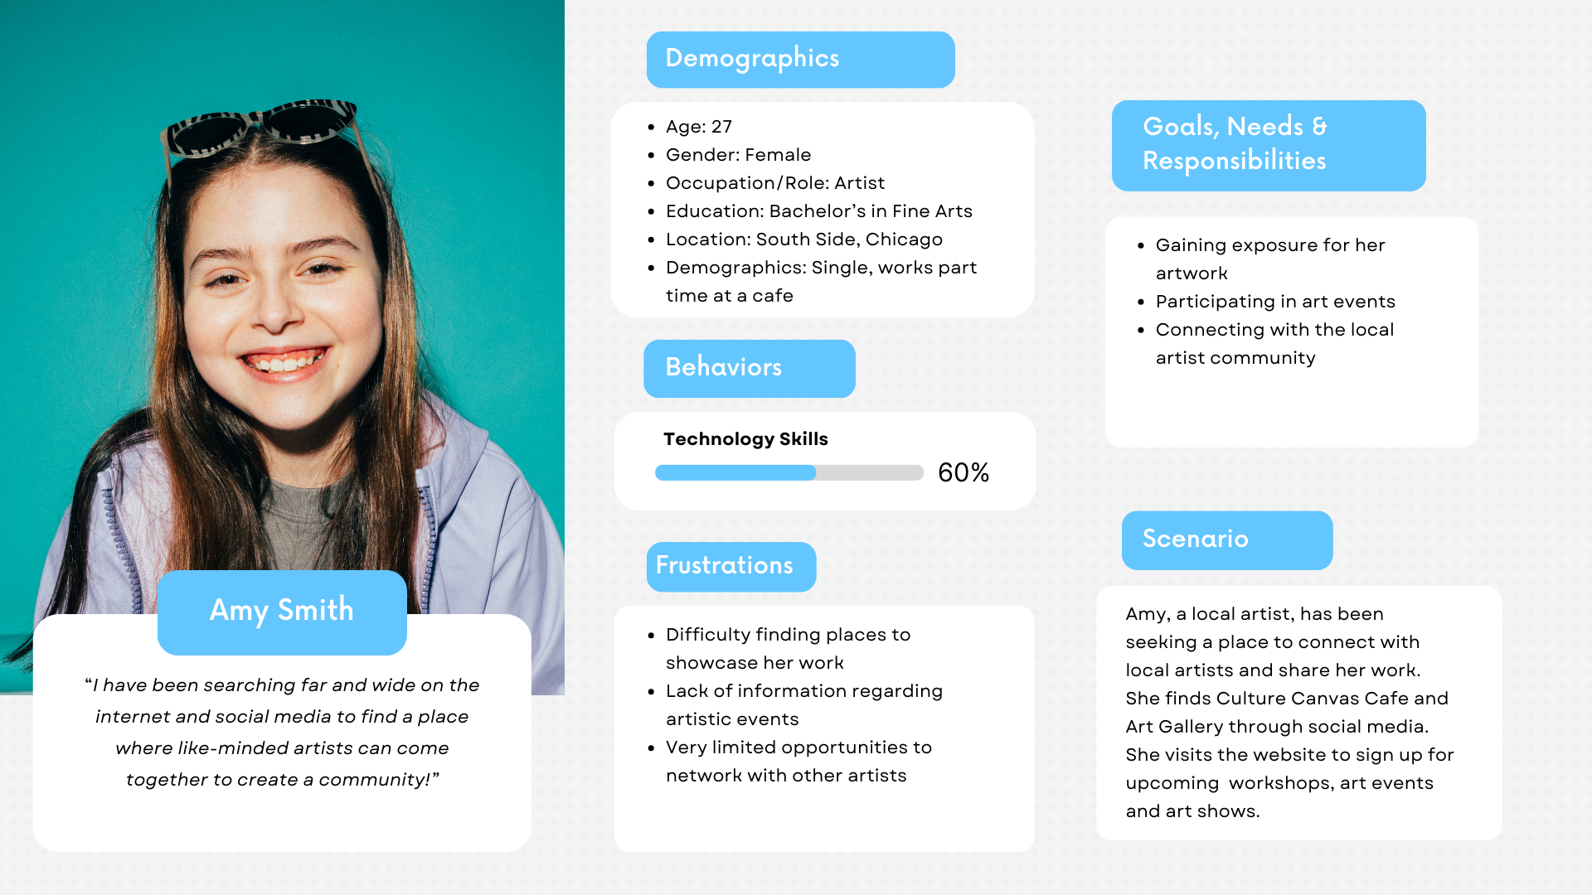
Personas Persona #1

Slide 4
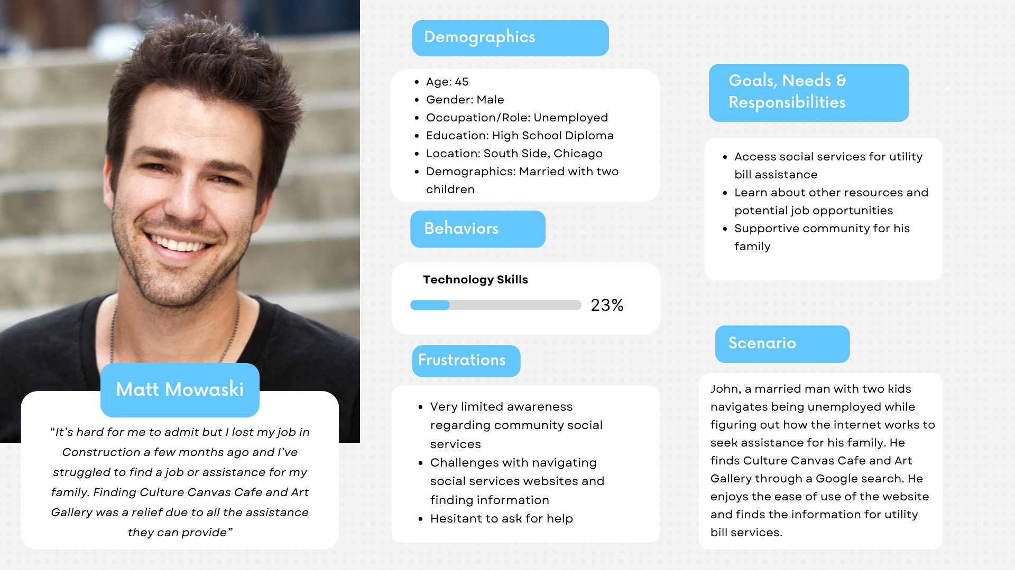
Personas Persona #2

Slide 5
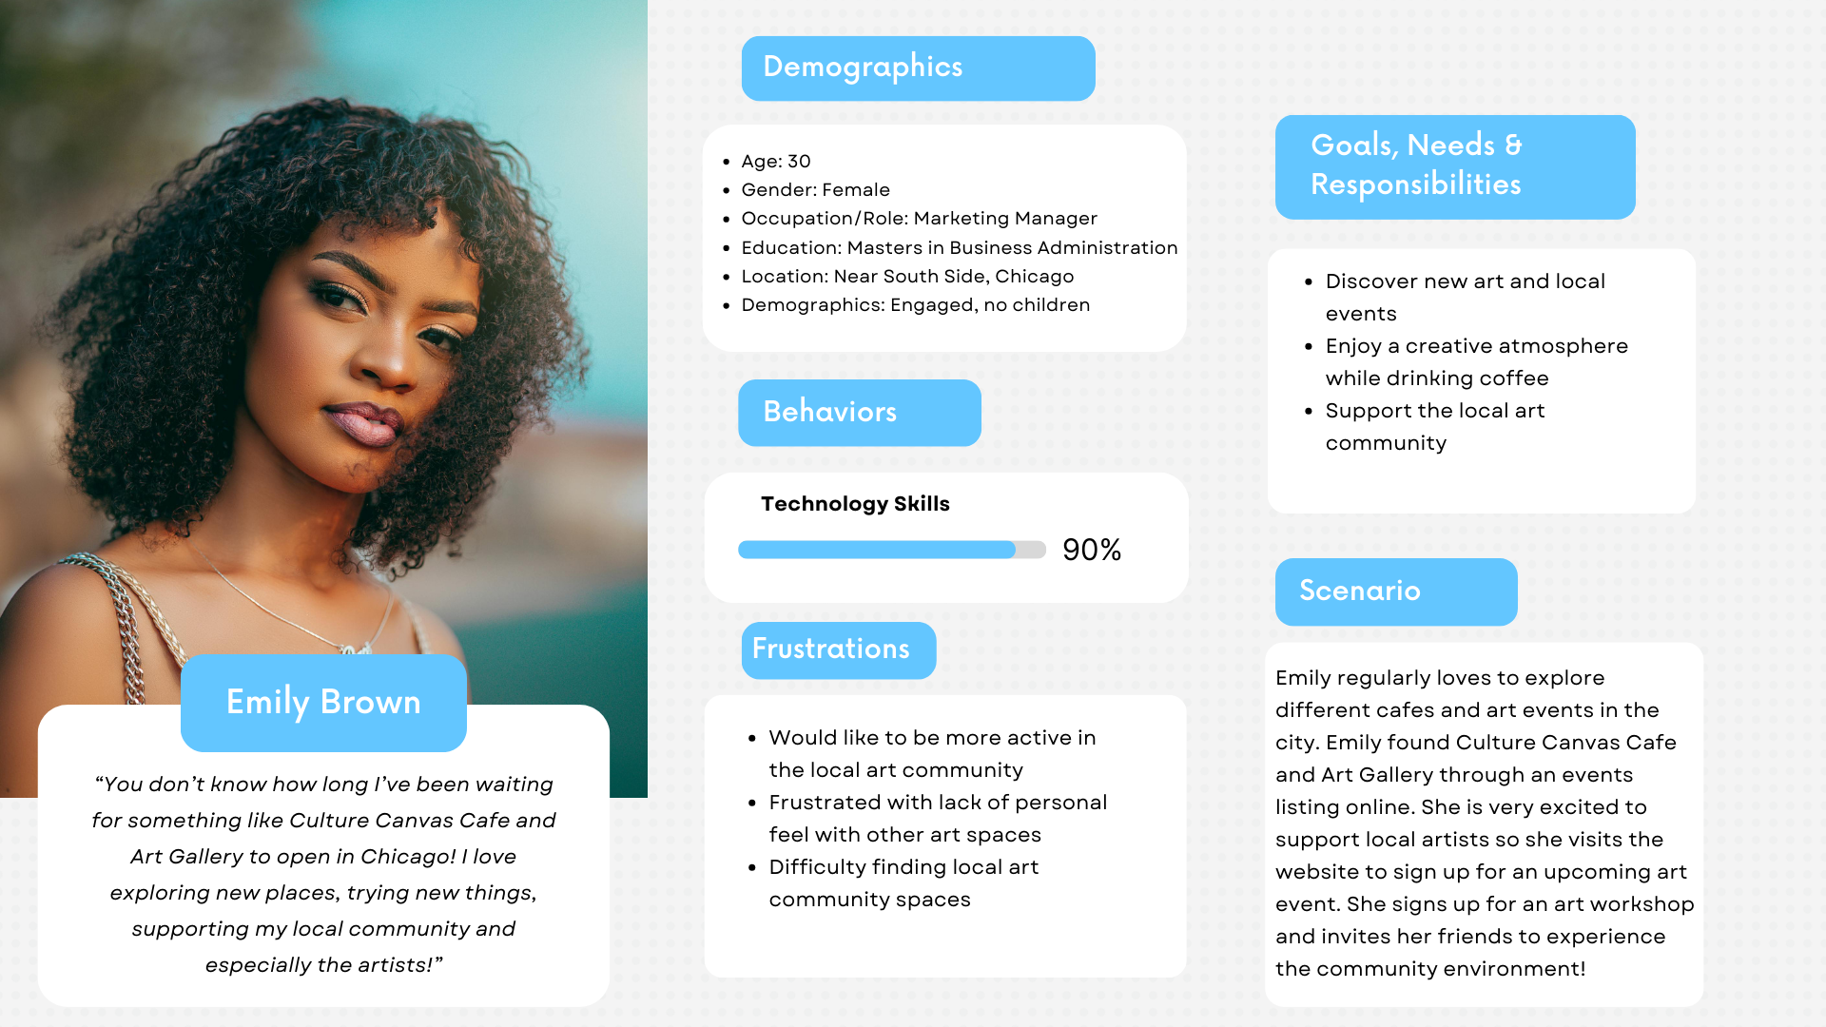
Personas Persona #3

Slide 6
Information Architecture Content Structure
Major Categories for Website
Home Page Welcome message/picture of café Quick links to major sections
Art Exhibits Upcoming exhibitions Current exhibitions Past exhibitions Artist Bios
Café Menu Food and drink options Order for pickup Daily specials
Social Services Utility bill assistance Additional community resources Contact for help
Events Event calendar (art shows, workshops, meetings, etc.) Sign up for events
Artists Local artist profiles Submit artwork
About Us Mission statement Location and hours Contact info

Slide 7
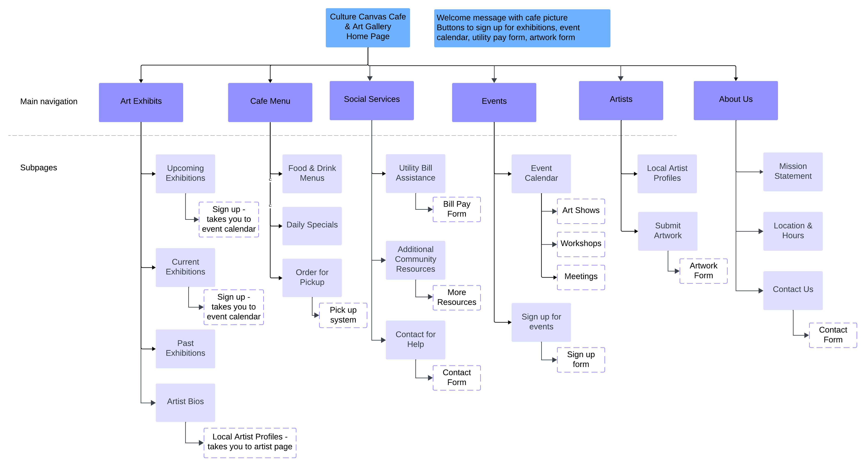
Information Architecture Site Map

Slide 8
Information Architecture Navigation Design
The user will navigate the website through numerous page sections using tabs and buttons
Navigation Bar (Top Menu) Select specific section for Home, Art Exhibits, Café Menu, Social Services, Events, Artists and About Us. Dropdown menus for each section to show specific subcategories
Footer Links Contact Us, Social Media Links, Terms & Condition, Privacy Policy
Buttons Buttons on the homepage and specific pages for specific actions like “sign up for events”,“submit your artwork” and “order for pickup”

Slide 9
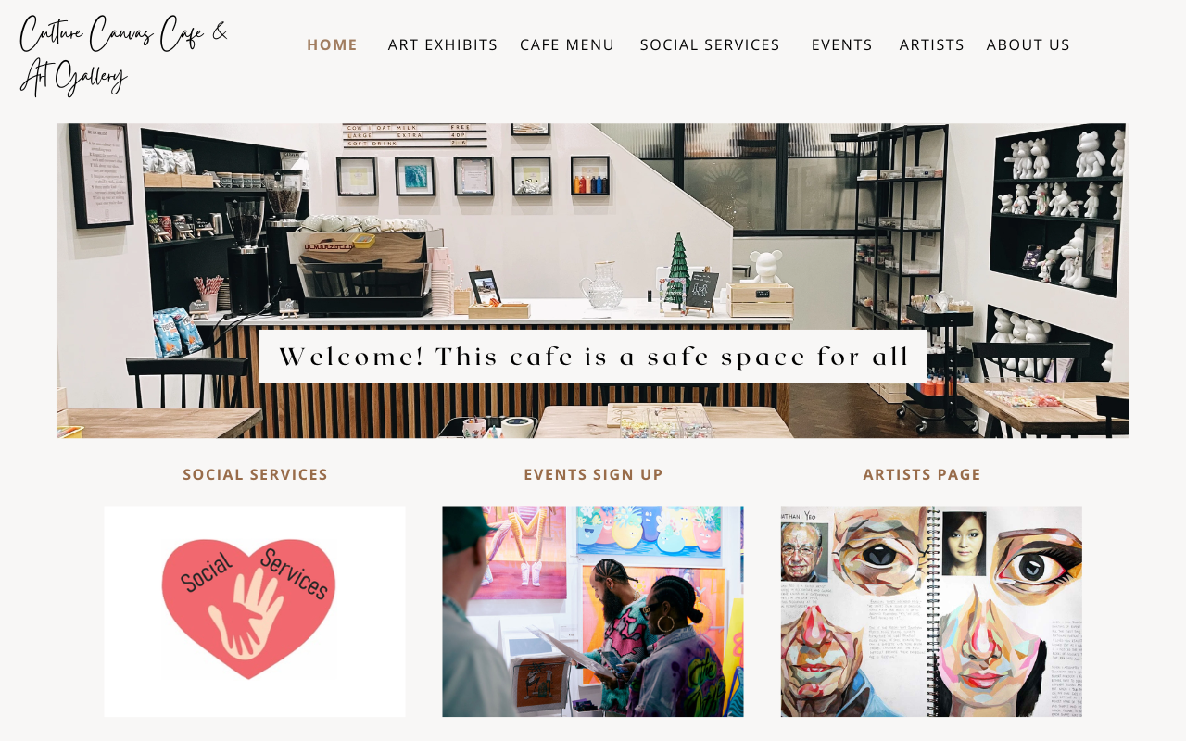
Prototype
Notes:
This design project would help the organization be more appealing to the user, with a clean, concise yet creative design. It will allow for people needing resources to quickly access them, for new users to gain clear information and artists will appreciate the creative design.
I learned how to think in terms of the user and put myself in someone else's shoes in a technology perspective. I now know how to create user centered design.

Slide 10
Thank you!
Arjana
Culture Canvas Café & Art Gallery Final Project

